Slide 1
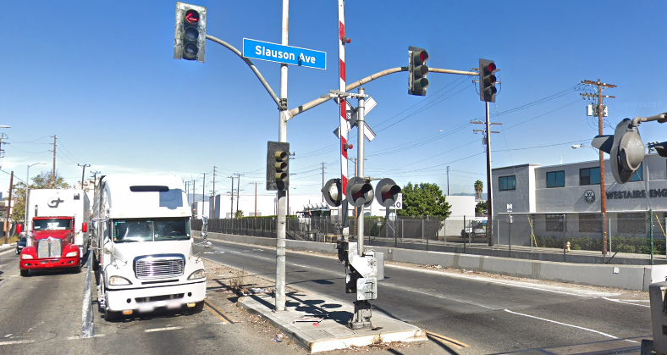

Proposed I-710 Early Action Project
City of Huntington Park
Slauson Avenue Capacity
Enhancement Improvements
I-710 TAC Meeting August 2018

Slide 2

Overview
Project Location and Need
Project Description
Project Funding Criteria

Slide 3
Project Location and Need
Location:
Slauson Avenue from Alameda St to Downey Rd/Malburg Way
Borders Vernon, Un-incorporated Los Angeles County and City of Los Angeles
Need:
Provide intersection capacity enhancements on Slauson Avenue during peak hours
Capacity increases by installing 3 through lanes of traffic on Slauson at intersections
Improve vehicular-pedestrian safety operations, and intersection capacity

Slide 4
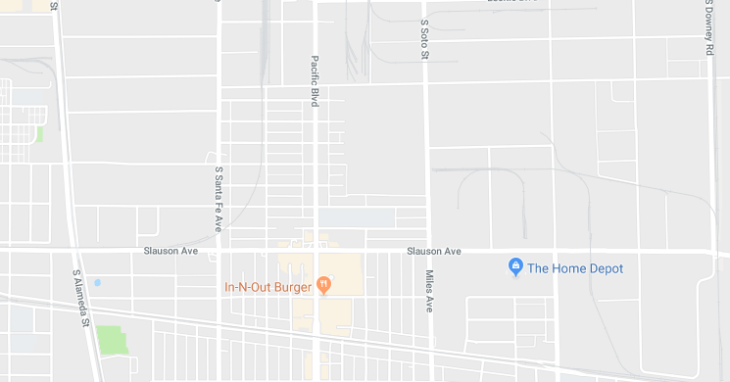
Vicinity Map
Slauson/Alameda #68 Existing & 2040 w/o project LOS: D AM / E PM
Slauson/Miles-Soto #69 Existing & 2040 w/o project LOS: E AM / F PM
Slauson/Santa Fe #151 Existing LOS & 2040 w/o project LOS: F AM / F PM
Project
Project
Slauson Ave/Alameda St
Slauson Ave/Miles Ave & Soto St
Slauson Ave/Boyle Ave
Slauson Ave/Santa Fe Ave
Slauson Ave/Pacific Blvd
Slauson Ave/Downey Rd

Slide 5
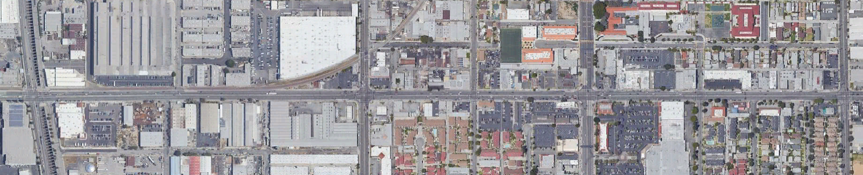
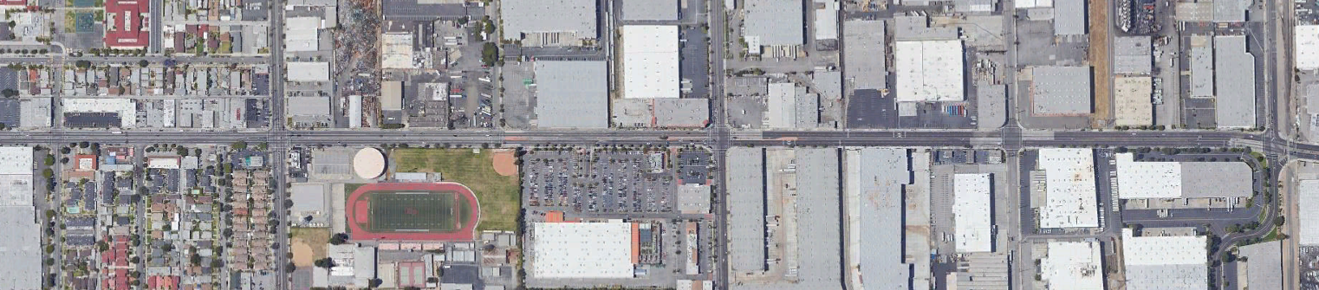
Existing Conditions
Slauson through the project intersections provides 2 thru lanes, dedicated left turn pockets and right turn only lanes. Current Corridor LOS is E for AM and F for PM Peak Hr
Alameda St
Santa Fe Ave
Pacific Blvd
Soto St
Slauson Ave
Soto St
Boyle Ave
Downey Rd
Slauson Ave
Miles Ave

Slide 6
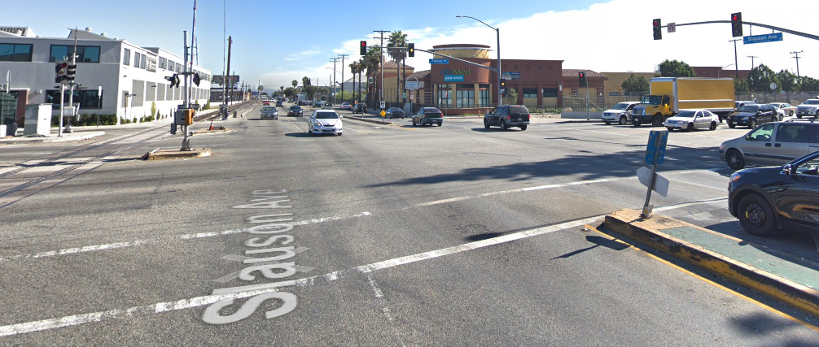
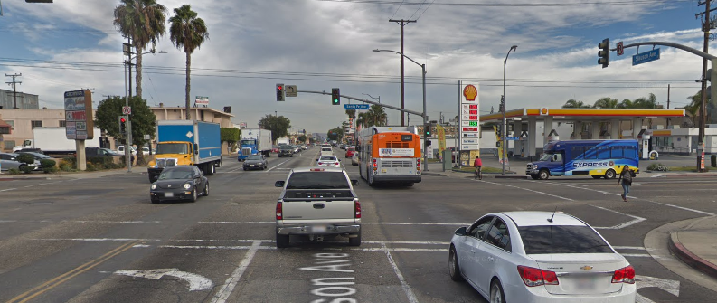
Site Images
Intersection of Slauson Ave/Alameda St
Intersection of Slauson Ave/Santa Fe Ave

Slide 7
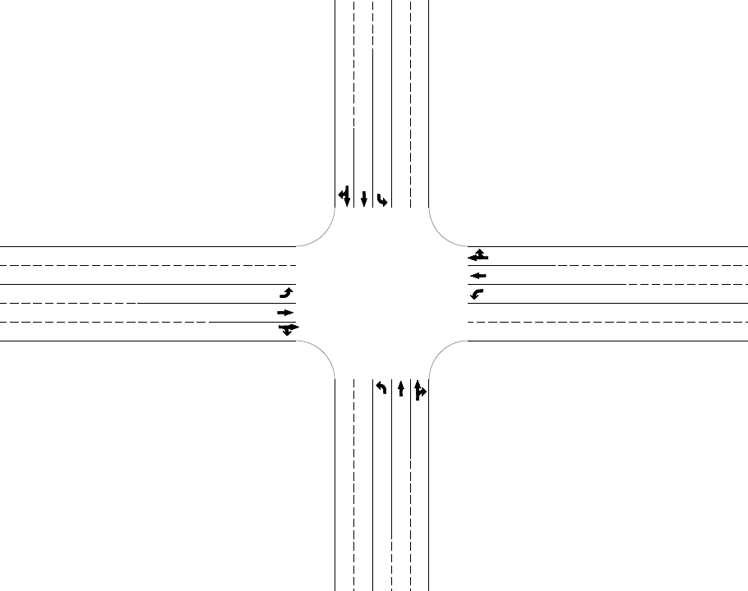
Traffic Conditions & Existing Improvements
Corridor Average Peak Hour Level of Service
Year | w/o Project |  | w/ Project
 | AM | PM | AM | PM
2015 | E | F | D | D
2040 | F | F | D | E
Parking CF
Parking CF
Improvement of existing traffic capacity and impacts of 710 project
Existing Conditions 1 left, 1 thru, 1 thru & right turn
Preliminary Engineering-funding requested
Environmental-funding requested
Construction-funding requested
Parking CF
Parking CF

Slide 8
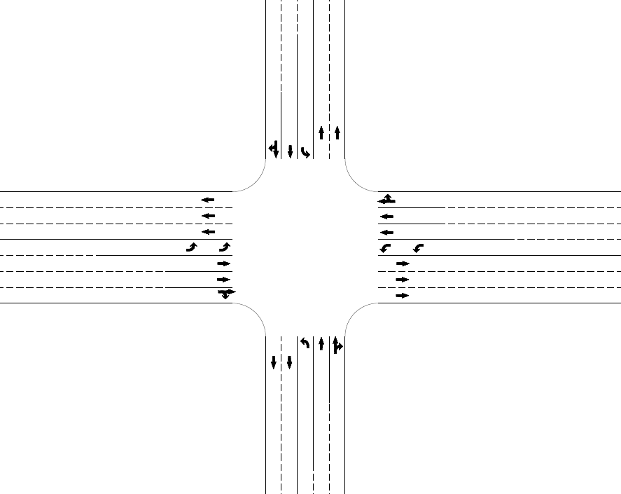
Proposed Improvements
Provide 3 thru lanes of travel through intersection. The curb lane being a thru movement/right turn, within 500 feet in each direction on Slauson Avenue only.
Remove and replace curbs curbs to provide 14 foot wide curb lane, decreasing existing parkway width
Remove/relocate parkway improvements and storm drain facilities
Signal, pavement improvements
Signal interconnect/synchronization
Green Streets/Pavement Improvements due to widening
Striping/Signage improvements, evaluate for shared bike lanes on Slauson Avenue
Move bus stops to far side of intersections
2040 LOS w/ project at intersections #68 – D AM / E PM; #69 – D AM / E PM; #151 – E AM / E PM
CF
CF
CF
CF
Re-align curb to obtain 14’ lane (typ)

Slide 9
Funding Criteria
Is the initial project consistent with the I-710 Alternatives as currently defined? How is the project consistent (provide details)?
- Yes, the project begins at the intersection of Slauson/Alameda and proceeds easterly
to the intersection of Slauson/Downey-Malburg
- The project encompasses the Early Action List of intersections of Slauson at Alameda
Intersection No. 68, 681; Slauson at Santa Fe Intersection No. 151; Slauson at Soto/Miles
Intersection No. 69; Slauson at State Intersection No. 170; and Slauson at Downey/Malburg
Intersection No. 169
2) Can the initial project stand alone by itself? Does it have independent utility? Can it be build consistent with existing and ultimate conditions in the I-710 corridor?
- Yes, the proposed project is needed to improve current capacity, operations and safety traffic safety conditions
- Independent Utility
- Beneficial to the City regardless of the I-710
- Will mitigate existing traffic congestion and deficiencies

Slide 10
Funding Criteria
3) Are there any costs that could be “lost” to make the project consistent with the potential ultimate configuration? If so, how much? Is the initial project consistent with the I-710 Alternatives as currently defined? How is the project consistent (provide details)?
- No lost cost
- Consistent with the mitigation recommended for all Alternatives, considered to date
4) What are the “risk” costs estimated to be associated with building the project early if the I-710 corridor design changes as currently proposed?
- No “risk” cost because the improvement will benefit the communities regardless of the I-710 corridor design

Slide 11
Funding Criteria
5) What clearance(s) does this initial project already have (or will have)? What is the status of the clearance(s)?
- The City will pursue a project specific Categorical Exemption supplemental to the
I-710 EIR
6) Is there local support (or opposition) for this initial project? Is this project a local priority?
- Hospital
- Transit
- School
- Adjoining Agencies, Vernon, Un-Incorporated County and City of Los Angeles
- No known opposition. This is a high priority to the City

Slide 12
Funding Criteria
7) What funding is being requested? What is the time frame for the funding request? Are there any existing funds, potential funding or matching funds (identify sources or potential sources)? Is the project consistent with the funding programmed for Measure R?
Requested Funding
Activity Costs
Preliminary Engineering, NPDES, Green Streets, PS&E $604,000
Environmental $40,000
Construction (Hard Costs) $3,750,000
Construction (Soft Costs) $506,000
Total Funding Request $4,900,000
- The project is consistent with the fund programmed for Measure R

Slide 13
Funding Criteria
8) What is the schedule for this potential initial early action project?
Activity | Timeline
 | Start | Complete
Approval by TAC committee | June 2018 | Fall 2018
Metro Approval of Funding | Winter 2018 | Jan 2019
Metro Agreement | Jan 2019 | Feb 2019
Preliminary Engineering | Spring 2019 | Summer 2019
Final PS&E | Summer 2019 | Jan 2020
Construction Bid & Award | Spring 2020 | Spring 2020
Construction | Summer 2020 | Summer 2022

Slide 14
Funding Criteria
9) Is there any other information that should be presented?
-All work to be completed within the existing right-of-way

Slide 15
Summary/Questions and Answers
Consistent with I-710 Project Goals
Improves existing traffic
Funding requested for project is $4,900,000

Slide 16
Thank You

